Slide 1
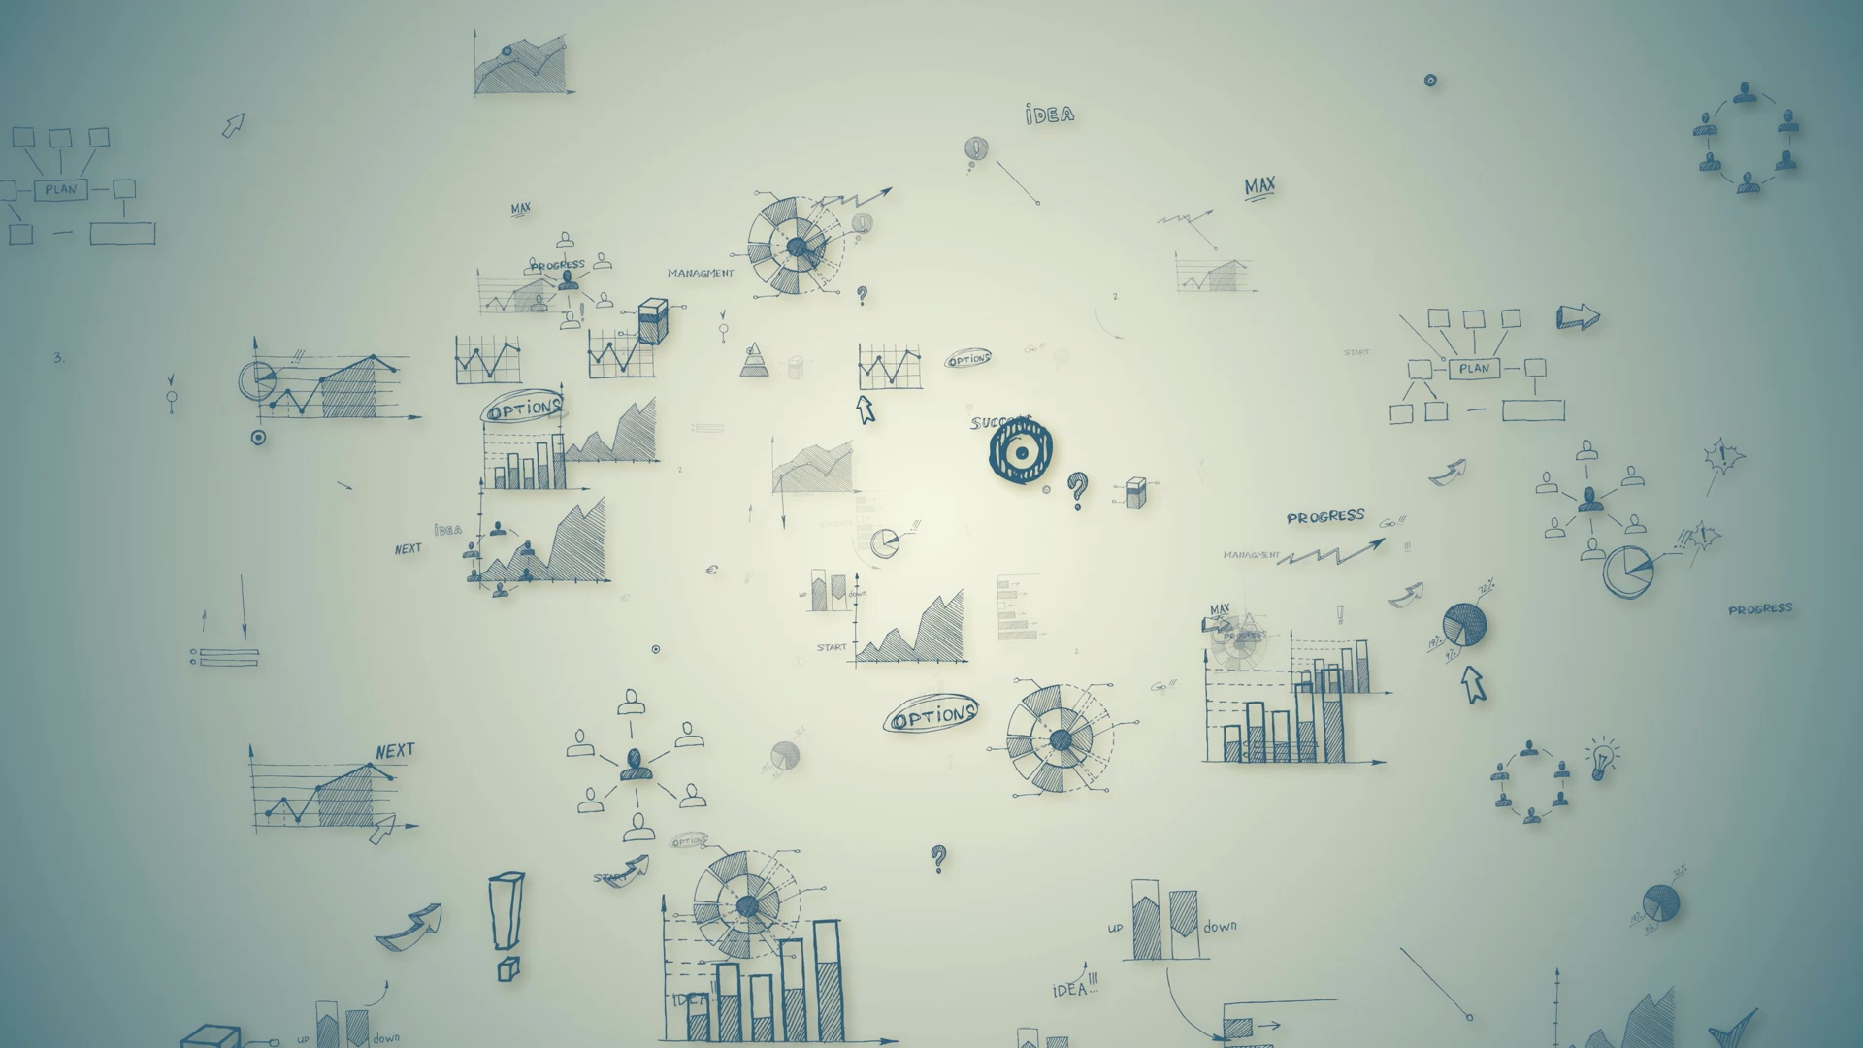
The Marketing Mix

Slide 2
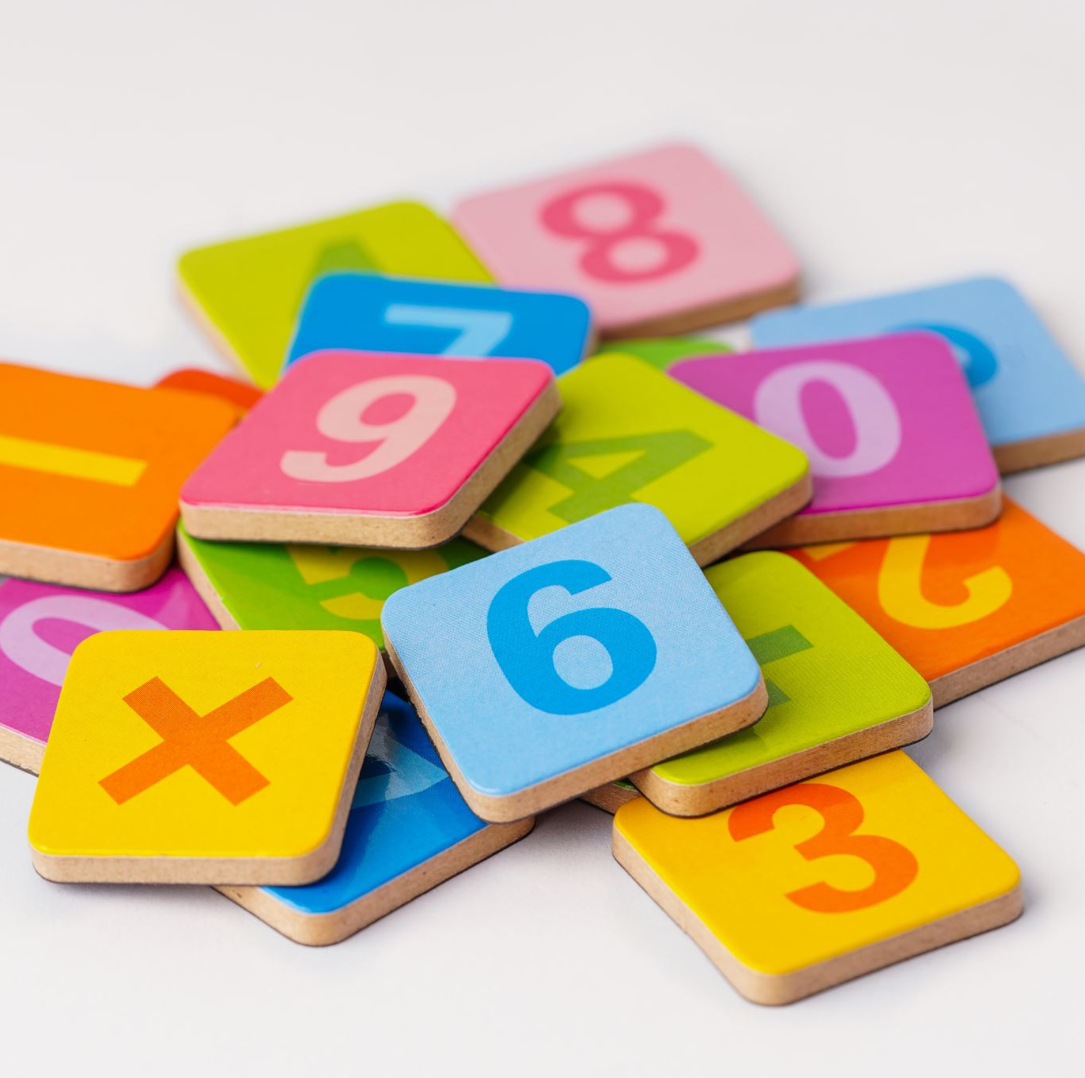
Assignment
Go to Google Classroom and Complete the ED-puzzle, what is marketing
Quick Write Activity: In your packet, if you owned a business, do you believe you would use Traditional marketing, Digital Marketing, or both methods?

Slide 3
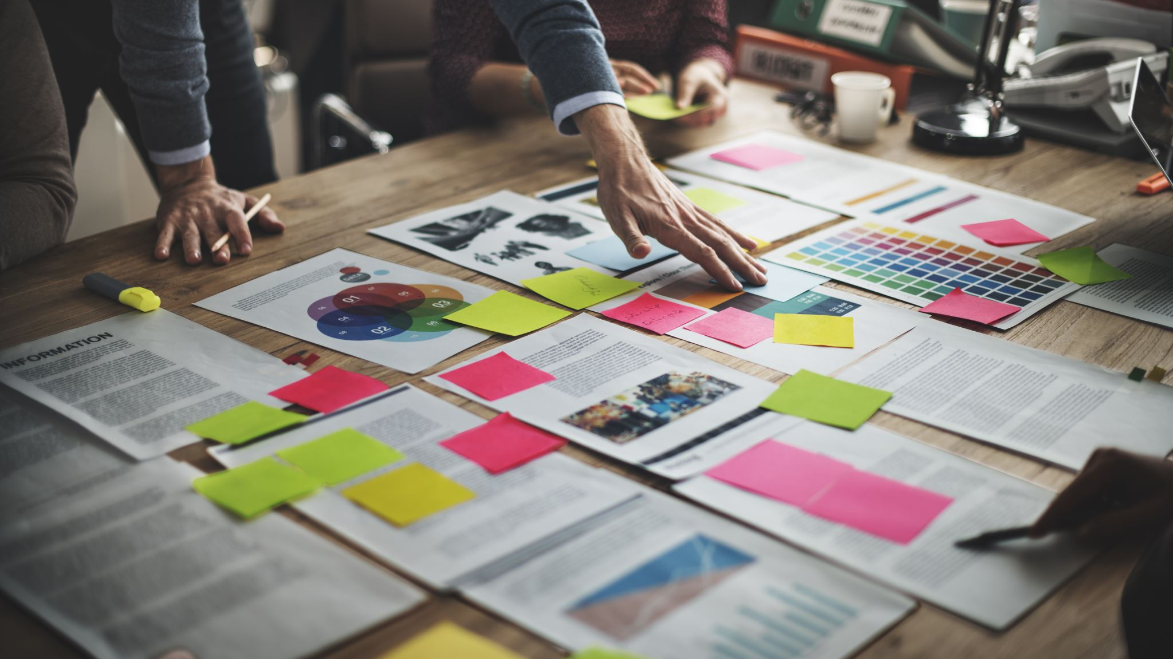
The Marketing Mix

Slide 4
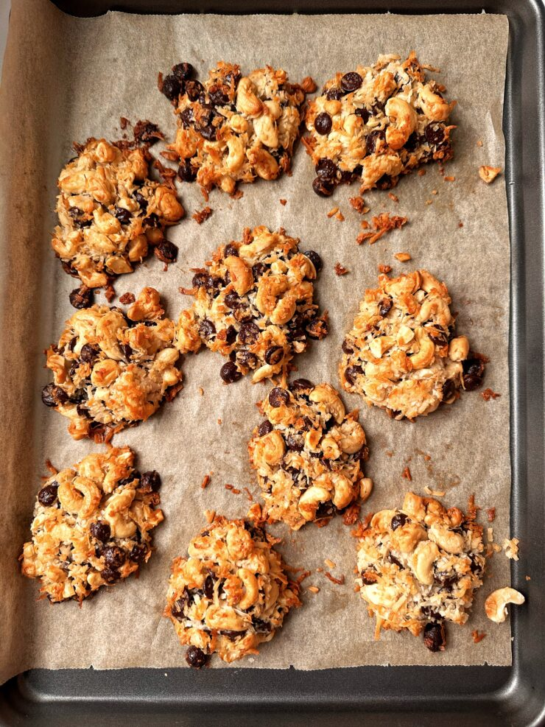
Marketing is Like a Recipe
Recipes combine various ingredients to make good food
Businesses combine 4 main elements of the “marketing mix” to attract customers and achieve success
Magic Cookies
2 cups cashews, cut into small pieces
2 cups unsweetened coconut flakes
1/2 can sweetened condensed coconut milk (about 6 ounces)
1 cup dark chocolate chips

Slide 5
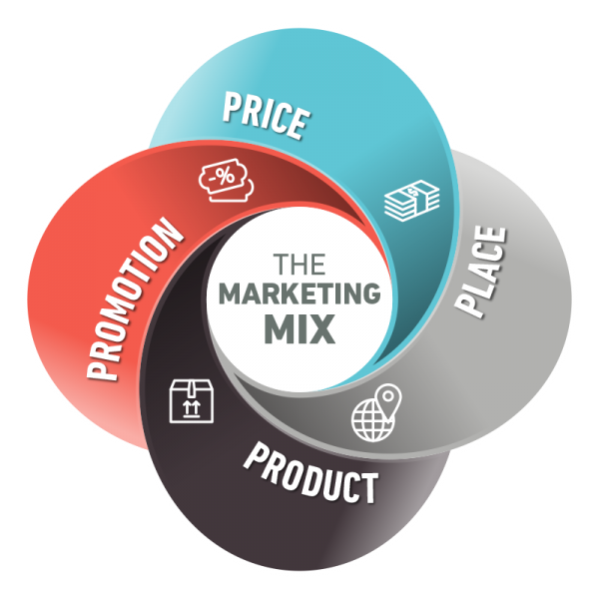
What are the 4 main ingredients of Marketing?

Slide 6
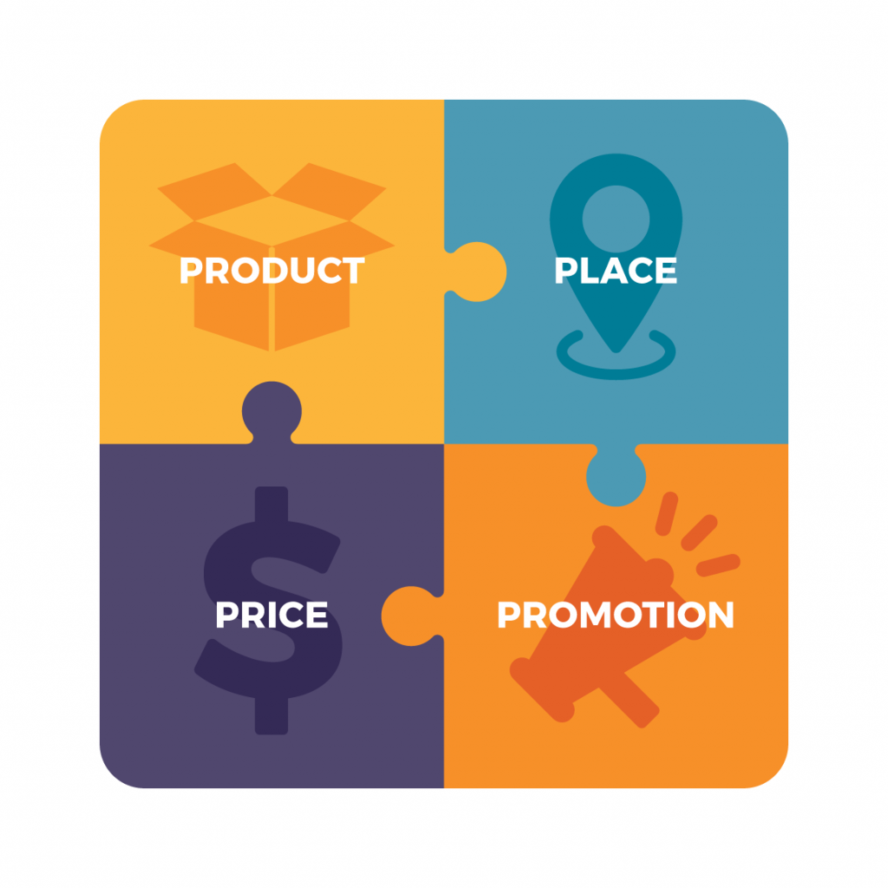
What is the Marketing Mix?
Marketing Mix: a unique blend of product, price, place, and promotion strategies designed to produce mutually satisfying exchanges with consumers
AKA Known as the 4ps of Marketing

Slide 7
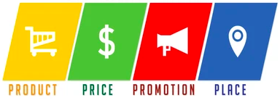
4 Components of the Marketing Mix
Product
Price
Place
Promotion

Slide 8
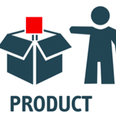
1. Product
Product: Developing goods or services that meet customer needs
The product refers to what you are selling – do you sell one product, many related products, or many different products
Product decisions involve
Features of the product
What design (varities, shapes, models, colors, sizes etc)
How you will brand it
How you will package it
What material is it made out of

Slide 9
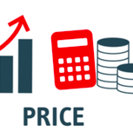
2. Price
Price refers to how much customers pay for each product so you still earn a profit.
What is your cost to produce/buy the products
How much will you Mark it up
Retail Price – What the consumer will pay
Tier Pricing
Subscription Pricing
Will you package it with a Bonus
It is often the most flexible of the 4 P’s – the quickest element to change

Slide 10

3. Place
Place refers to where customers find and purchase the product.
It involves making products available to customers when and where they want them
Place decisions Include
Online platforms – Your own site and other sites
In retail stores – Brick and mortar locations
Downloadable (Streaming)
Going Mobile (Food Trucks)
Shipping to Customers (Amazon)
Place is your distribution channels or what methods will be used for the customer to get the product

Slide 11

4. Promotion
Promotion refers to how you let customers know about your products. Communicating the value of product or services to potential customers
Promotion Key Decisions include
Advertising
Personal selling
Customer Loyalty Programs
Public relations
Sales promotion
Social media
Promotion is about creating awareness and interest. Successful promotion creates a buzz and encourages customers to consider the product

Slide 12
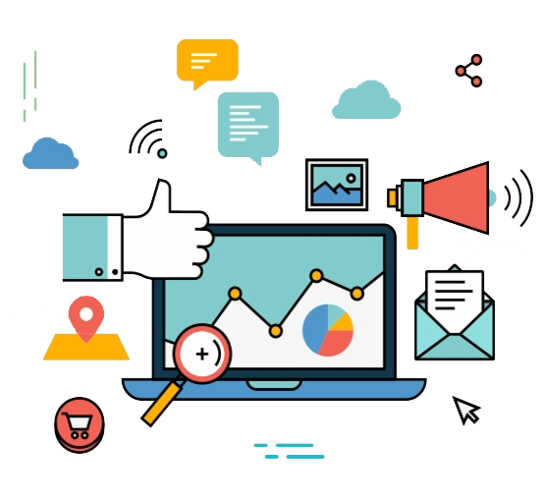
Marketers can control each component of the marketing mix, but the strategies for all four components must be blended together to achieve optimal results and to best meet the needs of customers

Slide 13

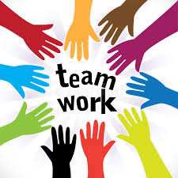
Assignment
Table Talk:
Complete the McDonalds Happy Meal 4ps of Marketing Activity

Slide 14
Assignment
Go to Google Classroom and complete the Marketing Fundamental’s quiz

Slide 15
Assignment
Mrs. Vetter will divide you into groups randomly:
Steps to completing:
You will draw a business name
You will use the internet to find the 4Ps of Marketing for that Business
You will Create a Presentation Board for the business
You will present your Business to the class.
Your Boards will be hung up in class

